Slide 1
Colour Detection
Done by – R Prudhvi Raj

Slide 2
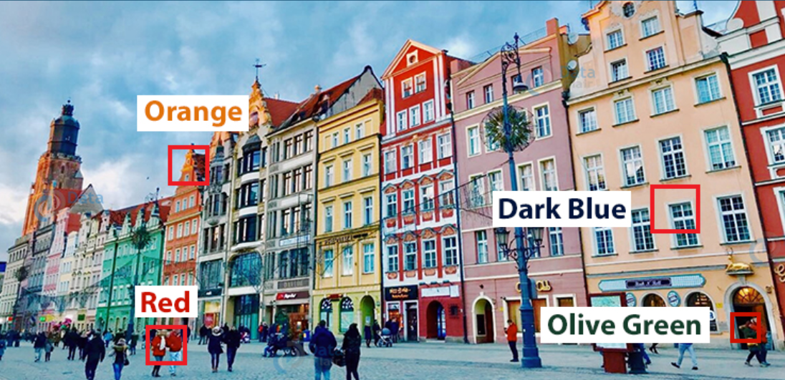
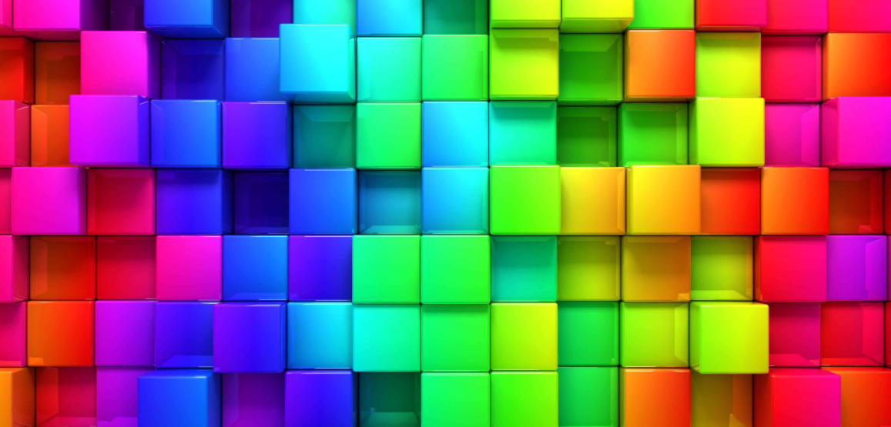
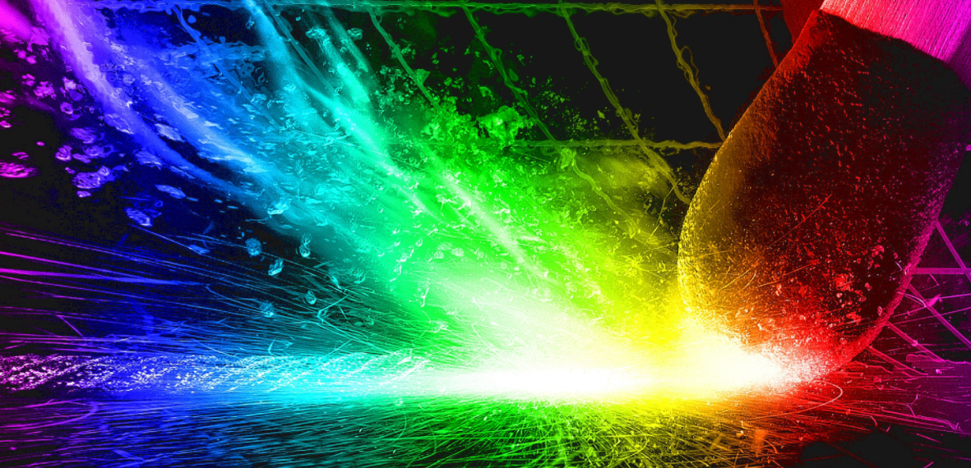
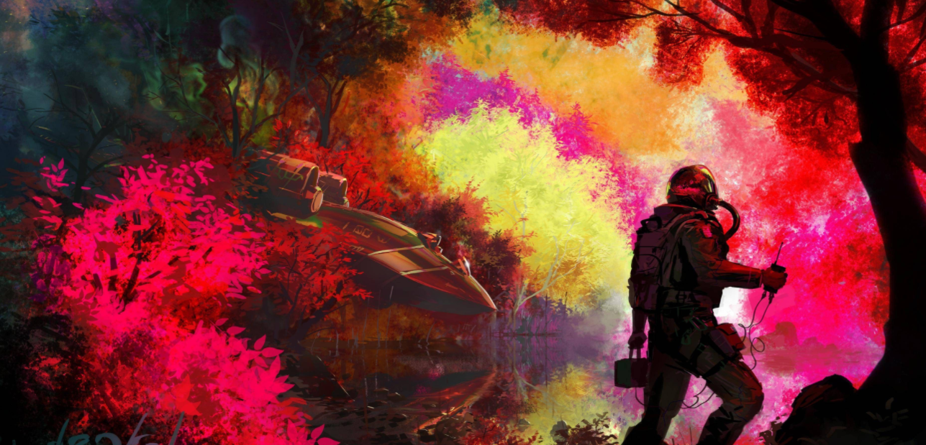

Slide 3

ABSTRACT
Colour detection is the process of detecting the name of any color. Simple isn’t it? Well, for humans this is an extremely easy task but for computers, it is not straightforward. Human eyes and brains work together to translate light into color. Light receptors that are present in our eyes transmit the signal to the brain. Our brain then recognizes the color. Since childhood, we have mapped certain lights with their color names. We will be using the somewhat same strategy to detect color names.

Slide 4
Colour Format and Calculation
Colors are made up of 3 primary colors; red, green, and blue. In computers, we define each color value within a range of 0 to 255. So in how many ways we can define a color? The answer is 256*256*256 = 16,581,375. There are approximately 16.5 million different ways to represent a color. In our dataset, we need to map each color’s values with their corresponding names. But don’t worry, we don’t need to map all the values. We will be using a dataset that contains RGB values with their corresponding names.

Slide 5
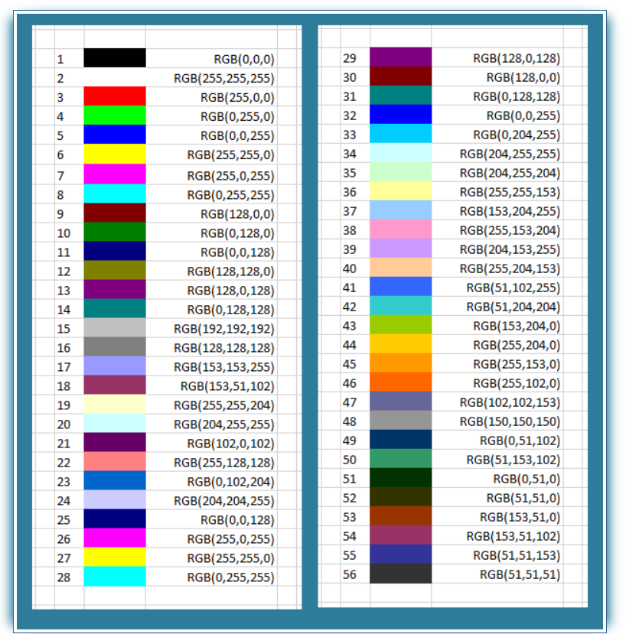

Slide 6
v Hardware Requirement:
Ø i3 Processor Based Computer or higher
Ø Memory: 1 GB RAM
Ø Hard Drive: 50 GB
Ø Monitor
v Software Requirement:
Ø Windows 7 or higher
Ø Python

Slide 7
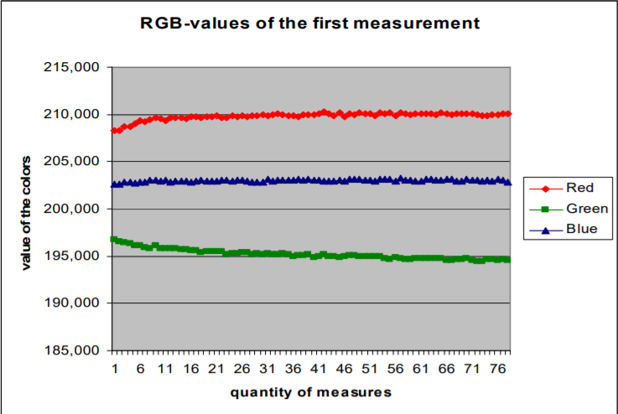

Slide 8
Prerequisites
Before starting with this Python project with source code, you should be familiar with the computer vision library of Python that is OpenCV and Pandas.
OpenCV, Pandas are the Python packages that are necessary for this project in Python.

Slide 9
Main Modules
We will use three main modules for this project. They are Pandas and OpenCv. OpenCv is a highly optimized library with a focus on real-time applications.
OpenCV (Open Source Computer Vision Library) is an open-source computer vision and machine learning software library. OpenCV was built to provide a common infrastructure for computer vision applications and to accelerate the use of machine perception in commercial products.

Slide 10


